Slide 1
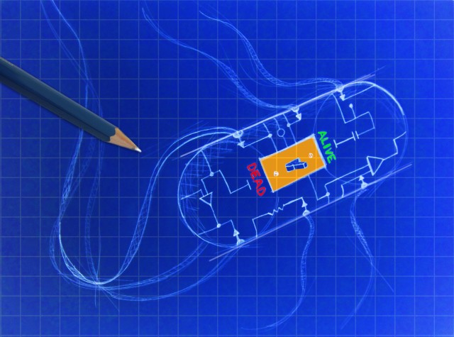
Building a Kill Switch in Bacteria

Slide 2
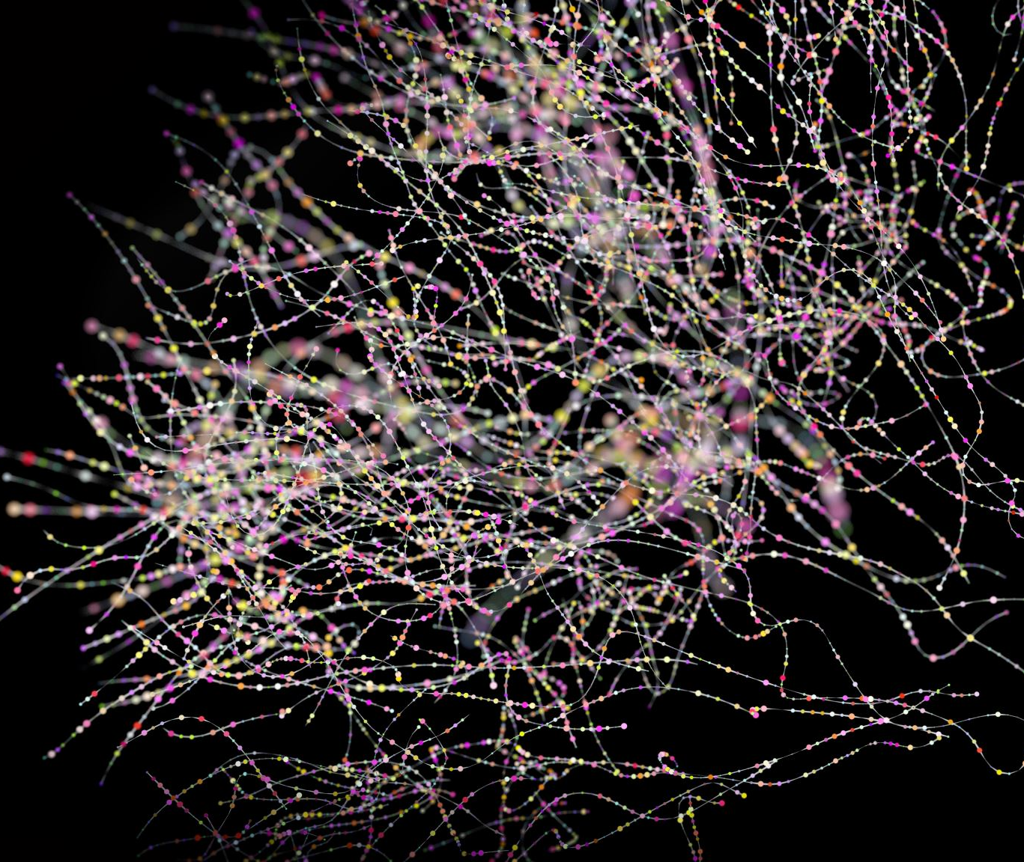
Polymerase Chain Reaction (PCR)

Slide 3
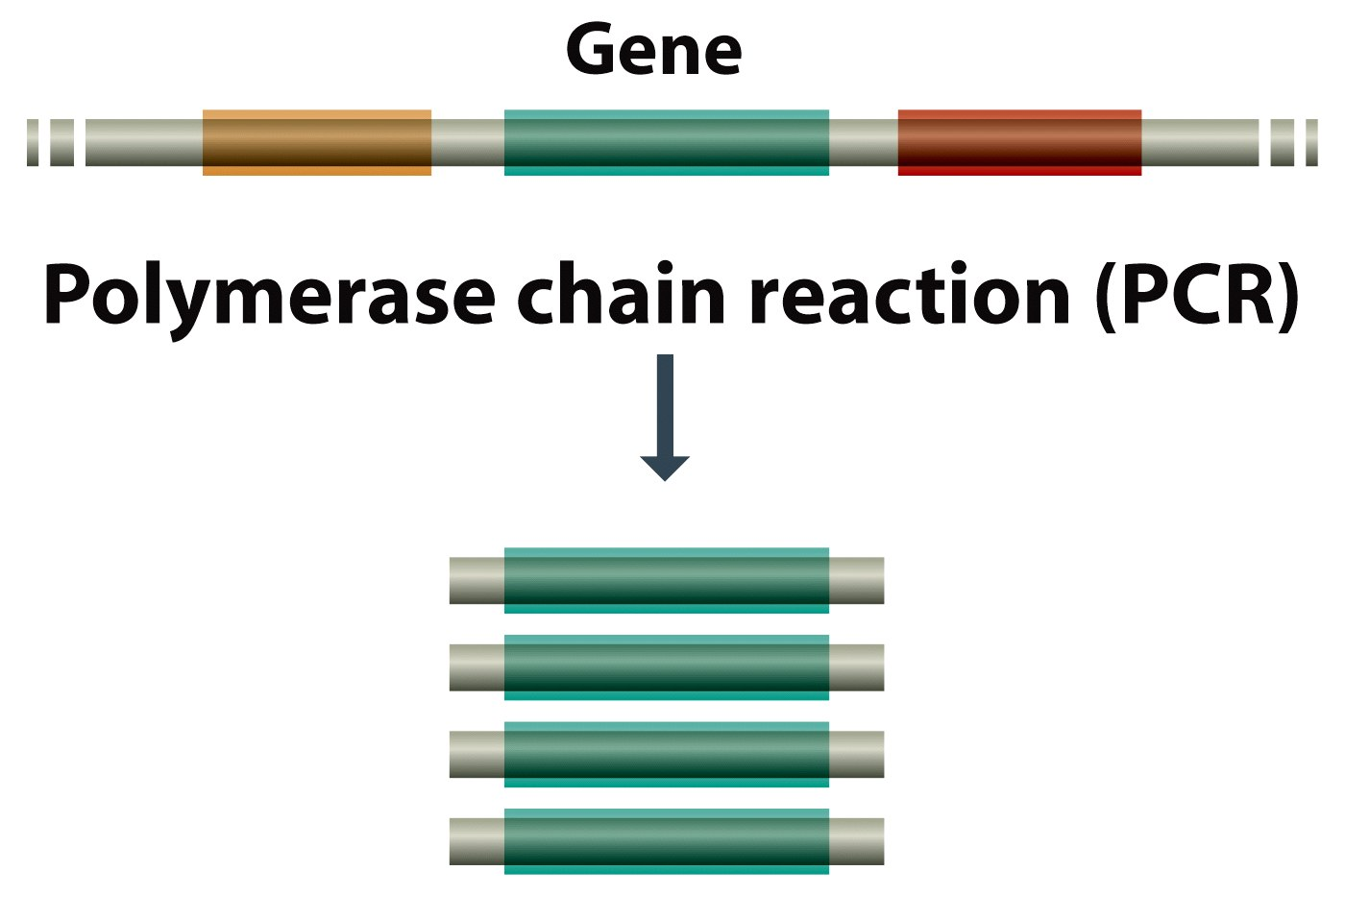
A method for amplification of a DNA template
Figure 2.3 Genomes 3 (© Garland Science 2007)

Slide 4
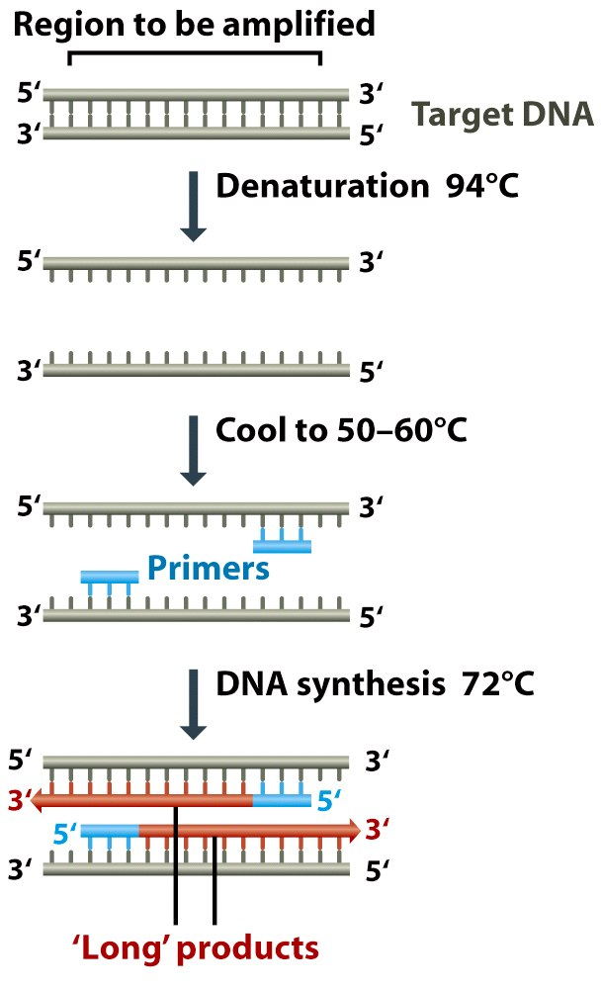
Figure 2.28 Genomes 3 (© Garland Science 2007)

Slide 5
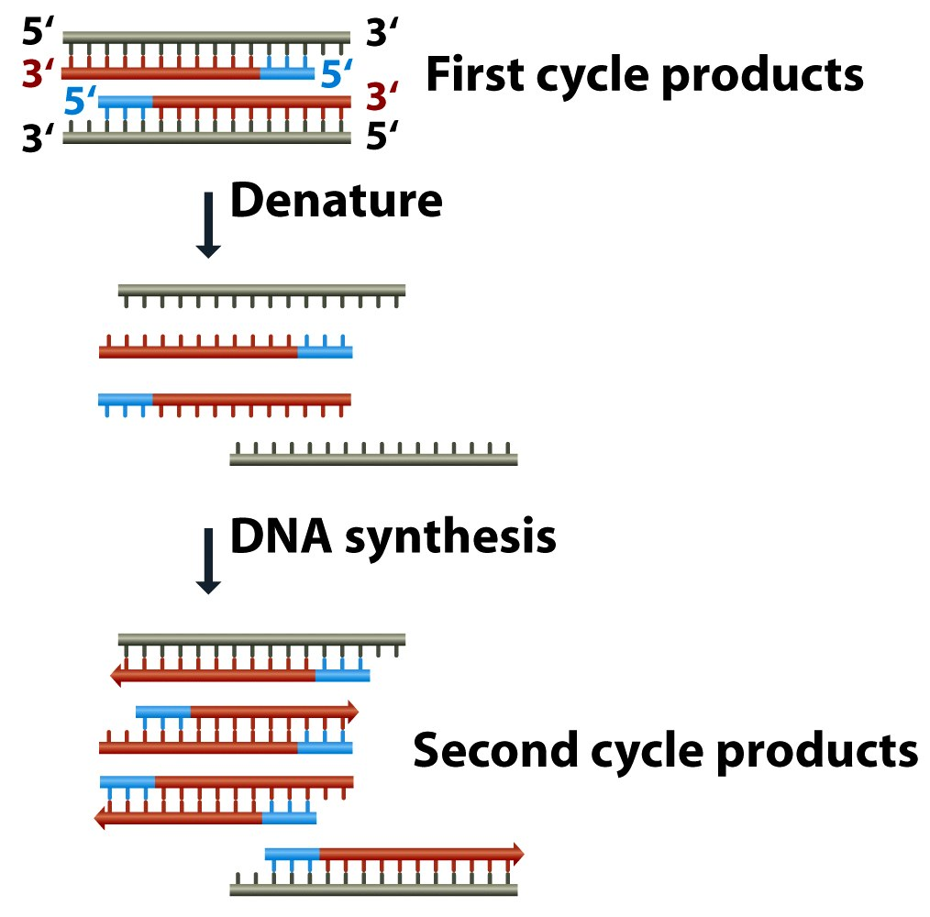
PCR amplification
Figure 2.29 (part 1 of 2) Genomes 3 (© Garland Science 2007)

Slide 6
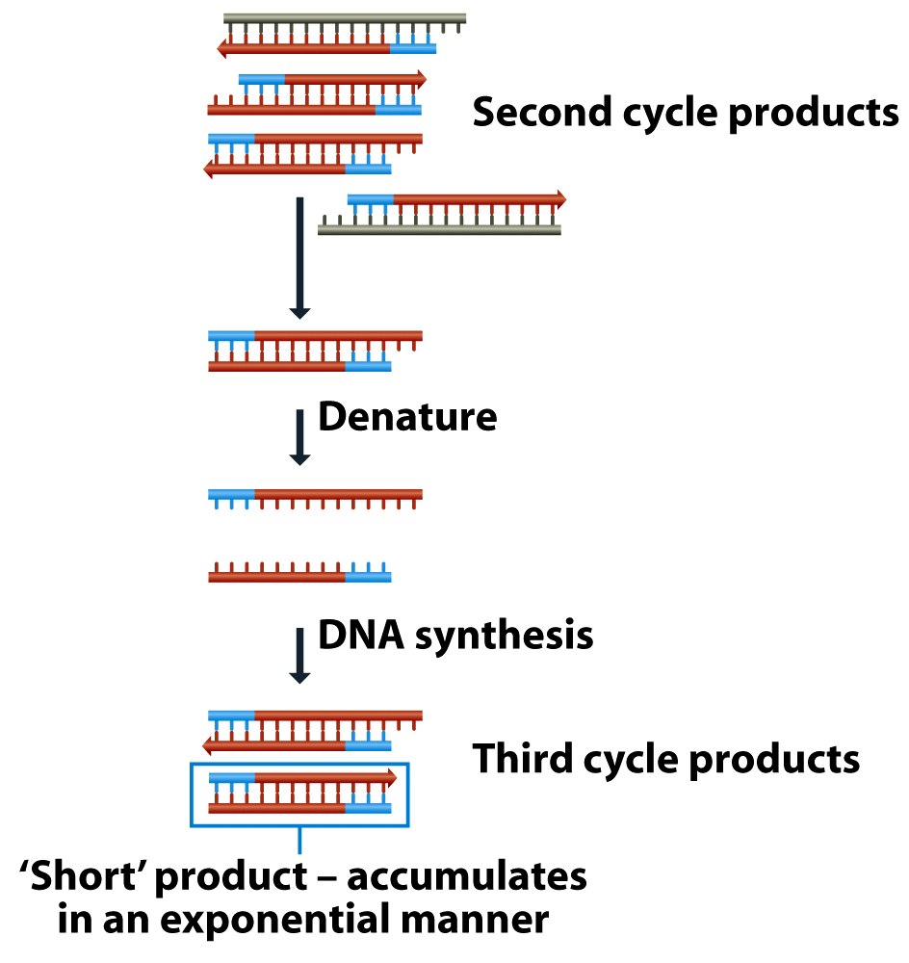
Figure 2.29 (part 2 of 2) Genomes 3 (© Garland Science 2007)

Slide 7
Components of a PCR reaction
Template DNA
Primers
Polymerase enzyme
Buffer
Nucleotides (dNTPs)
Figure 2.28 Genomes 3 (© Garland Science 2007)

Slide 8
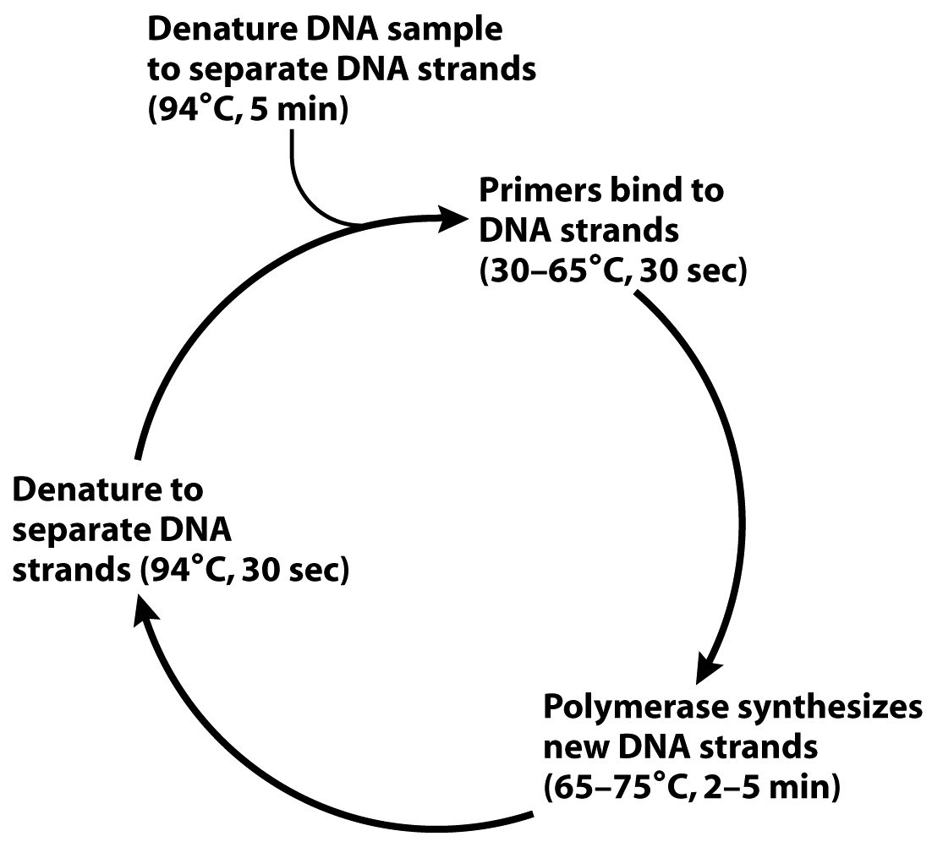
PCR uses thermal cycling to amplify DNA
2. Anneal
2. Anneal
1. Denature
1. Denature
3. Extend
3. Extend

Slide 9
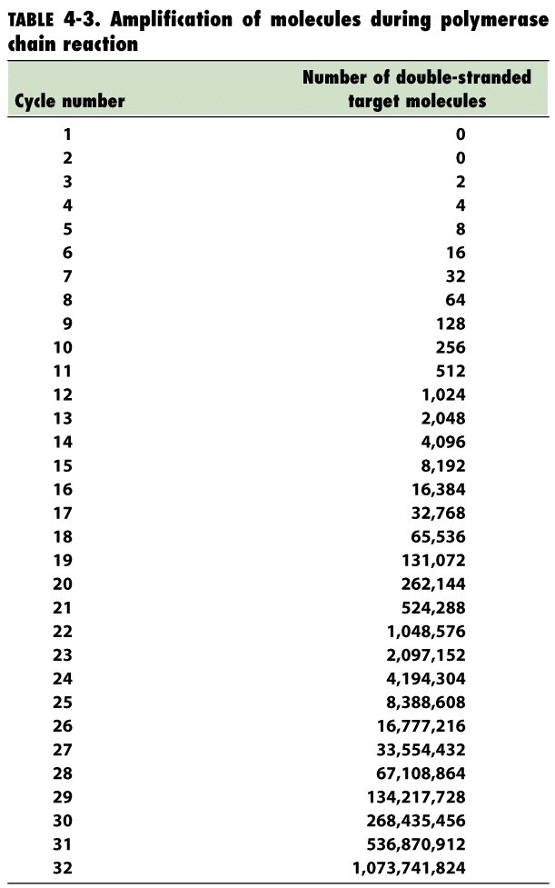
PCR amplifies DNA exponentially

Slide 10
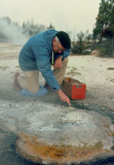
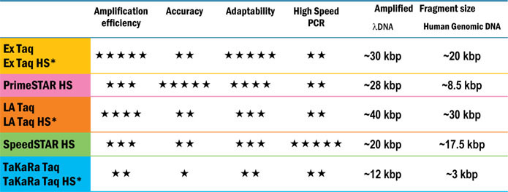
Thermal cycling is possible due to the use of Taq polymerase and its derivatives
Taq polymerase is the DNA polymerase that is used by the bacterium Thermus aquaticus
It survives multiple cycles at high temp
There are many Taq derivatives with different properties depending on your need

Slide 11
What’s the big deal about PCR?
Amplifies exponentially (makes lots of product)
Highly specific (only amplifies gene of interest)
Highly sensitive (can amplify from very small amounts of template)
  This also makes is prone to contamination
  Be sure to use negative controls!

Slide 12
Using controls in a PCR reaction

Slide 13
Important uses of PCR
Basic research
Clinical uses
Quantification of gene expression
Detection of mutations or evolutionary changes
Study of metagenomes (population-based sequencing)
Providing DNA templates for cloning or sequencing
Mutagenesis of DNA
Drug discovery
Classification of organisms
Virus testing
Forensic DNA analysis
GMO analysis
Detection of mutations
Detection and identification of pathogens
Blood typing
Donor matching for transplant
Gene therapy
Prenatal diagnosis
Identification and classification of wildlife

Slide 14
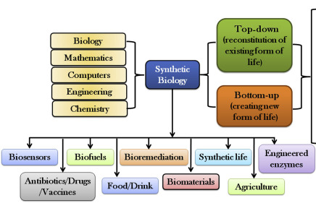
Synthetic Biology
https://www.sciencedirect.com/topics/engineering/synthetic-biology

Slide 15
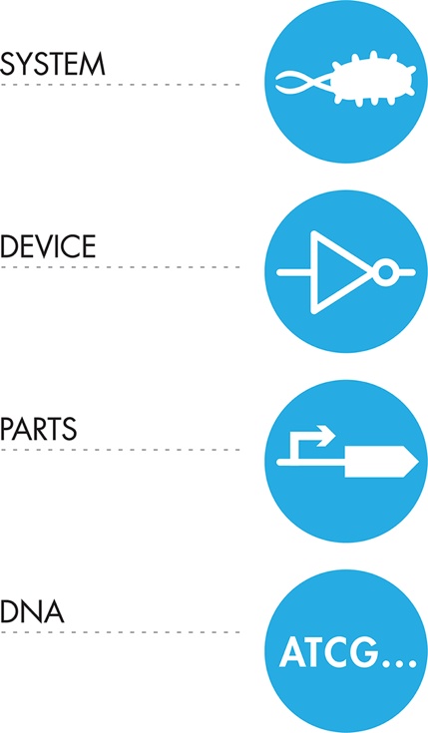
Principles of SynBio: Hierarchical assembly

Slide 16
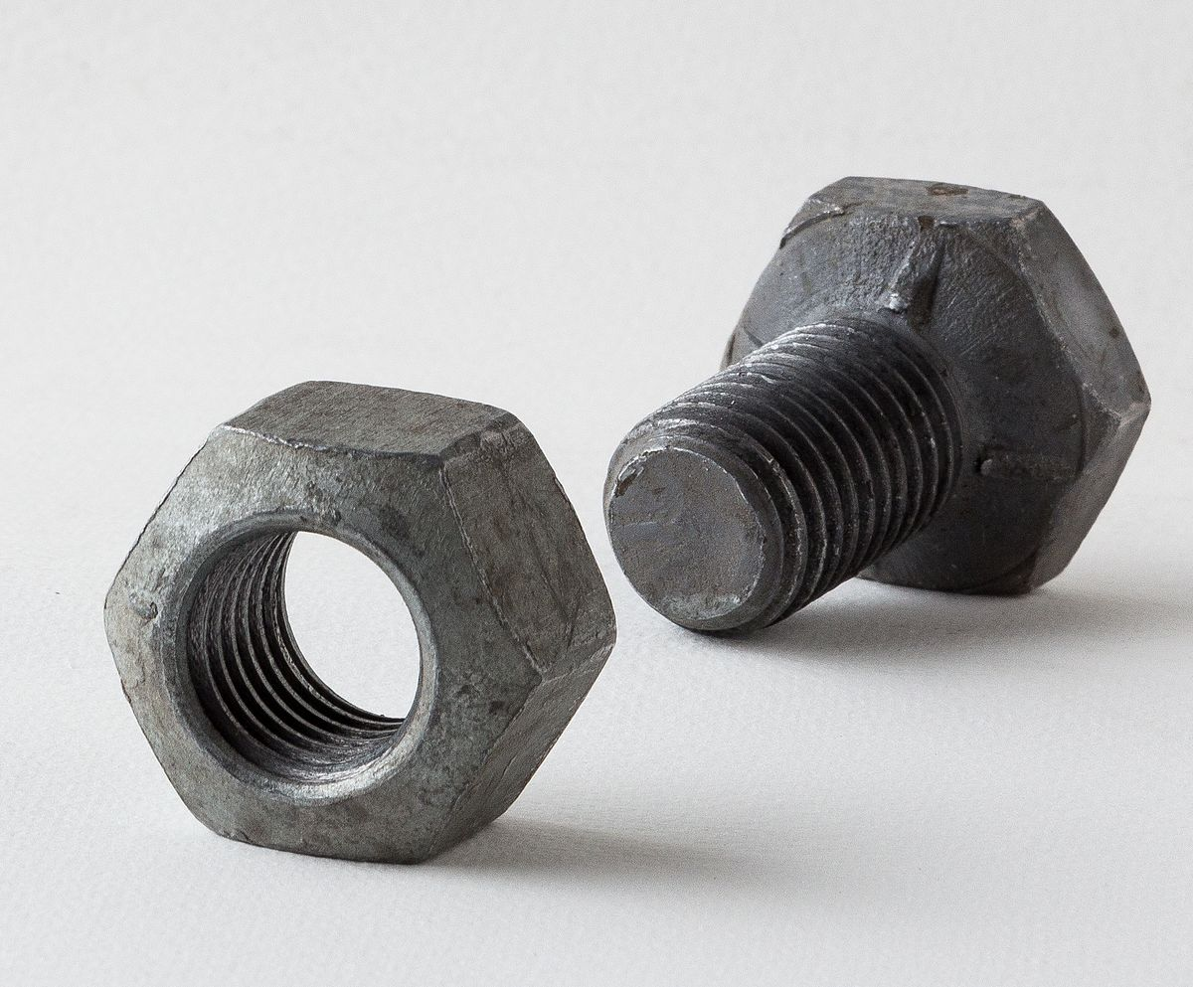
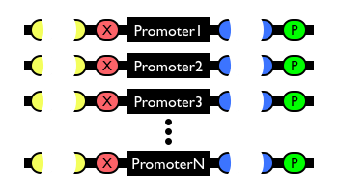
Principles of Syn Bio: Standardization

Slide 17
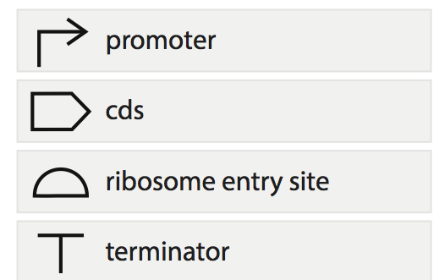
Principles of SynBio: Modularity
Start transcription
Protein-coding sequence
(includes translation stop)
Start translation
Stop transcription

Slide 18
In this class
We’ll amplify and then combine a promoter/
With a protein-coding sequence
ribosome entry site combination
And clone into a vector that already has a terminator

Slide 19
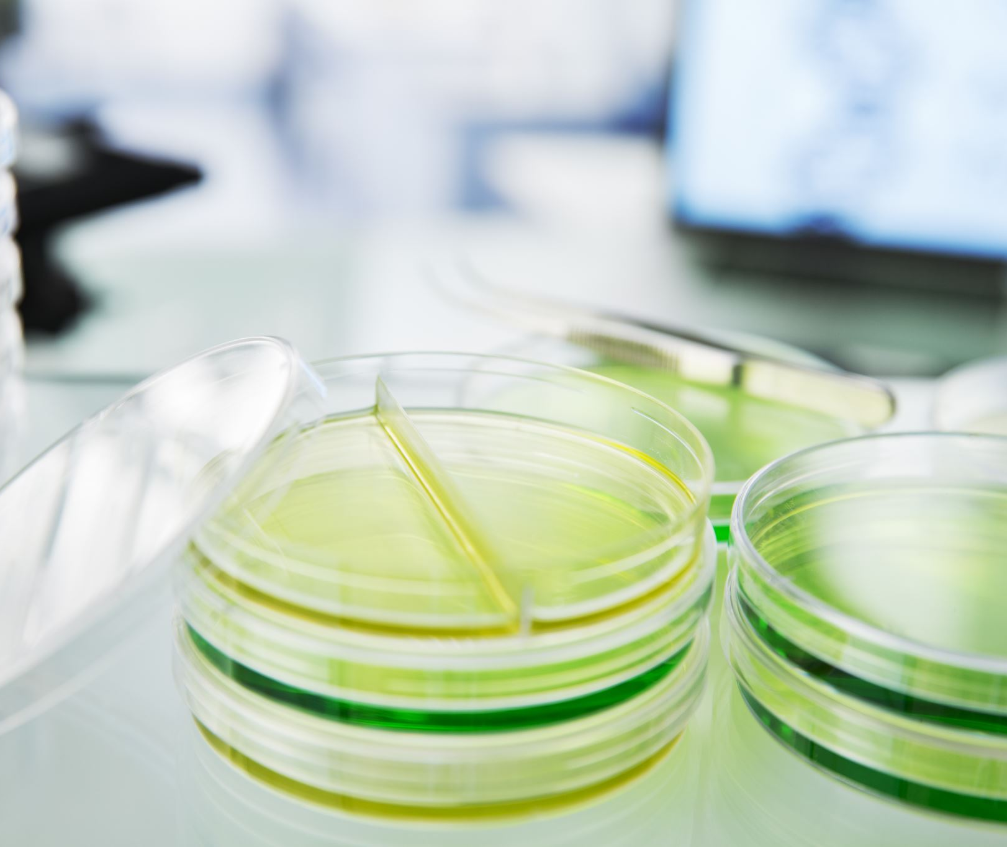
Biocontainment

Slide 20
Uses of microbes in human clinical applications
Vaccines
Gene therapy
CRISPR gene editing
CAR T therapy
Probiotic-delivered therapies such as for Crohn’s disease
Bacteria-mediated tumor therapy

Slide 21
What is the concern?

Slide 22
How do we contain these organisms?
Biocontainment
Biocontainment: cells only grow when provided with essential supplement
  Make strains auxotrophic
  Make strains dependent on synthetic amino acids
But
  this requires constant additional supplementation
  metabolites can be scavenged from the natural environment
  Organisms can reacquire essential genes from other organisms

Slide 23
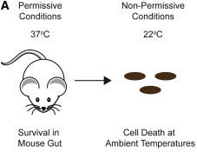
How do we contain these organisms? Kill switch
Kill switch
  Needs a trigger
    Chemical
    Temperature
    RNA structure
    Cell density
  Mechanism of killing
https://doi.org/10.1016/j.molcel.2017.10.033
DOI: 10.1021/jacs.9b03300
J. Am. Chem. Soc. 2019, 141, 11103−11114

Slide 24
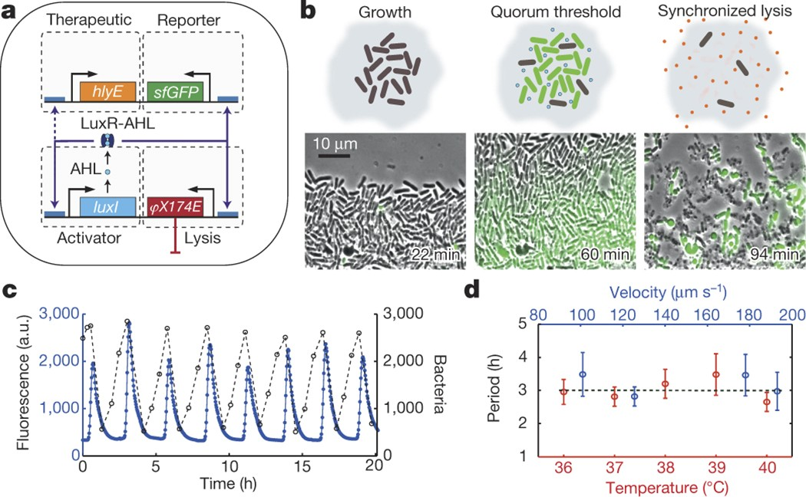
How do we contain these organisms? Kill switch
Kill switch
  Needs a trigger
    Chemical
    Temperature
    RNA structure
    Cell density
  Mechanism of killing

Slide 25
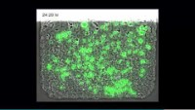
Density-dependent cell killing

Slide 26
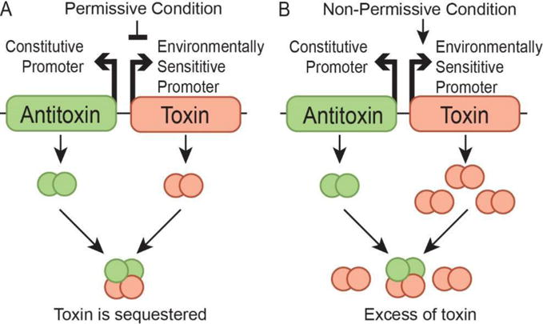
How do we contain these organisms?
Kill switch
Kill switch
  Needs a trigger
    Chemical
    Temperature
    RNA structure
  Mechanism of killing
    Express toxin or lysis protein
    Degrade essential proteins
    Cleave the genome using CRISPR
These are prone to mutational inactivation because of selective pressure to deactivate the toxic product
https://doi.org/10.1038/s41467-022-28163-5

Slide 27
How do we contain these organisms?
Addiction
Insert stop codons into many essential genes
Introduce transfer RNA that can read those stop codons and incorporate an amino acid

Slide 28
How do we contain these organisms?
Orthogonality

Slide 29
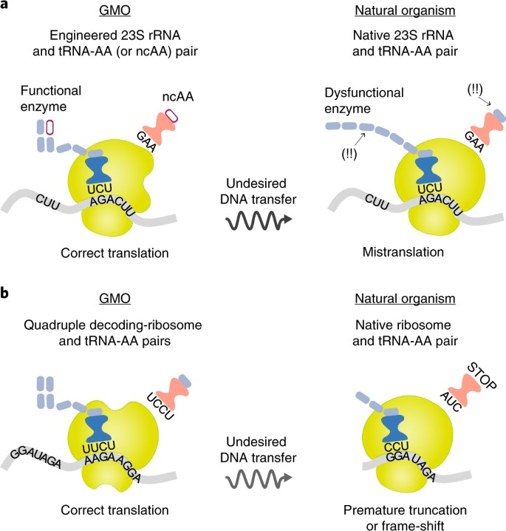
How do we contain these organisms?
Orthogonality

Slide 30
How do we contain these organisms?
Multi-faceted containment approaches
“Passcode” kill switch requires multiple environmental conditions
doi: 10.1038/nchembio.1979

Slide 31
How do we contain these organisms?
Multi-faceted containment approaches
Nucleic Acids Research, 2015, Vol. 43, No. 3

Slide 32
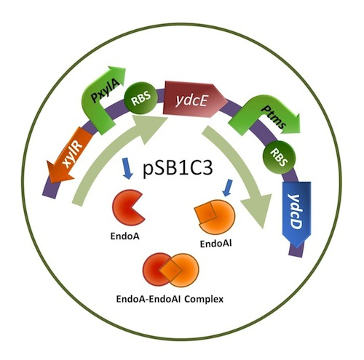
The system we’re working with
Constitutive promoter = ptms
Antitoxin = ydcD
Environmentally sensitive promoter = pXylA
Toxin = ydcE

